Slide 1


ALTSCHOOL OF Cybersecurity (BARAKA 2025)
MONTH 3 – WEEK 3

Slide 2
Refresher- week2
Network Security
  Introduction to Network Security
  Types of Threats to Network Security
  Introduction to Firewall and IDS/IPS
  Virtual Private Networks (VPNs)
  Network Security Best Practices
Setting Up VLans
  Configuring VLans and Network Security
  Setting up VLans in Cisco Packet Tracer
  Setting up basic firewall rules

Slide 3
MONTH 3 - WEEK 4
Cloud Computing Concepts
  Introduction to Cloud Computing
  Introduction to Cloud Computing Models (IaaS, SaaS, PaaS)
  Benefits and Challenges of Cloud Computing
  Cloud Service Providers (AWS, Azure, GCP, Huawei & Oracle)
  Cloud Security Basics (Shared Responsibility Model)
  Securing Cloud Infrastructure and Data
  Compliance in the Cloud
  Class Demo and Assignment

Slide 4
Introduction to Cloud Computing
Day 1

Slide 5

WHAT IS Cloud computing ?
Cloud computing is the on-demand delivery of IT resources over the Internet with pay-as-you-go pricing.
Instead of buying, owning, and maintaining physical data centers and servers, you can access technology services, such as computing power, storage, and databases, on an as-needed basis from a cloud provider like Amazon Web Services (AWS), Microsoft Azure, HUAWEI, Google Cloud Platform, Oracle Cloud Platform etc

Slide 6
Cloud computing
Organizations of every type, size, and industry are using the cloud for a wide variety of use cases, such as data backup, disaster recovery, email, virtual desktops, software development and testing, big data analytics, and customer-facing web applications.
For example, healthcare companies are using the cloud to develop more personalized treatments for patients. Financial services companies are using the cloud to power real-time fraud detection and prevention. And video game makers are using the cloud to deliver online games to millions of players around the world.

Slide 7
Cloud computing
Cloud computing is providing developers and IT departments with the ability to focus on what matters most and avoid undifferentiated work like procurement, maintenance, and capacity planning. As cloud computing has grown in popularity, several different models and deployment strategies have emerged to help meet the specific needs of different users. Each type of cloud service, and deployment method, provides you with different levels of control, flexibility, and management. .

Slide 8
Introduction to Cloud Computing MODELS
Day 1

Slide 9
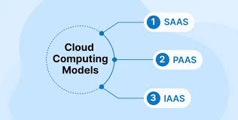
Cloud Computing Models (IaaS, SaaS, PaaS)
The three main types of cloud computing models include Infrastructure as a Service, Platform as a Service, and Software as a Service. Each type of cloud computing models provides different levels of control, flexibility, and management so that you can select the right set of services for your needs.

Slide 10
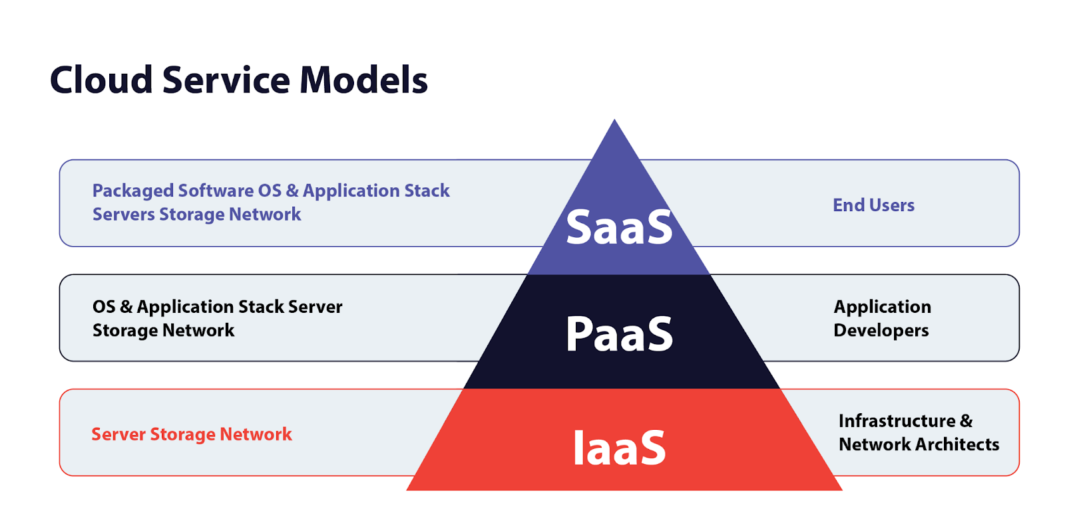
Infrastructure as a Service (IAAS)
Infrastructure as a Service (IaaS)
  IaaS contains the basic building blocks for cloud IT. It typically provides access to networking features, computers (virtual or on dedicated hardware), and data storage space. IaaS gives you the highest level of flexibility and management control over your IT resources. It is most similar to the existing IT resources with which many IT departments and developers are familiar.

Slide 11
Platform as a Service (PAAS)
Platform as a Service (PaaS)
  PaaS vendors remove the need for organizations to manage the underlying infrastructure (usually hardware and operating systems), and this integration allows you to focus on the deployment and management of your applications. This helps you be more efficient, as you don’t need to worry about resource procurement, capacity planning, software maintenance, patching, or any of the other undifferentiated heavy lifting involved in running your application.

Slide 12
Software as a Service (SAAS)
Software as a Service (SaaS)
  SaaS vendors provide you with software applications that are run and managed by the vendor. In most cases, people referring to SaaS are referring to third-party end-user applications. With a SaaS offering you do not have to worry about how the service is maintained or how the underlying infrastructure is managed; you only need think about how you will use that particular piece of software. A common example of a SaaS application is web-based email where you can send and receive email without having to manage feature additions or maintain the servers and operating systems that the email program is running on.

Slide 13
BENEFITS to Cloud Computing
Day 1

Slide 14
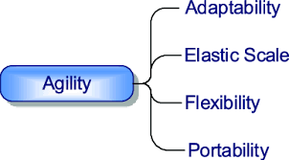
benefits of Cloud computing - AGILITY
AGILITY
  The cloud gives you easy access to a broad range of technologies so that you can innovate faster and build nearly anything that you can imagine. You can quickly spin up resources as you need them–from infrastructure services, such as compute, storage, and databases, to Internet of Things, machine learning, data lakes and analytics, and much more.
  You can deploy technology services in a matter of minutes, and get from idea to implementation several orders of magnitude faster than before. This gives you the freedom to experiment, test new ideas to differentiate customer experiences, and transform your business

Slide 15
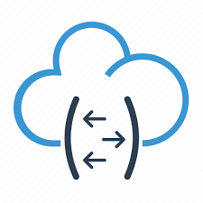
benefits of Cloud computing - ELASTICITY
ELASTICITY
  With cloud computing, you don’t have to over-provision resources up front to handle peak levels of business activity in the future. Instead, you provision the amount of resources that you actually need. You can scale these resources up or down to instantly grow and shrink capacity as your business needs change.

Slide 16
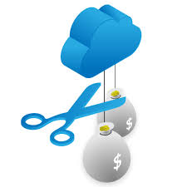
benefits of Cloud computing – COST SAVINGS
COST SAVINGS
  The cloud allows you to trade fixed expenses (such as data centers and physical servers) for variable expenses, and only pay for IT as you consume it. Plus, the variable expenses are much lower than what you would pay to do it yourself because of the economies of scale.

Slide 17

benefits of Cloud computing – speed
DEPLOY GLOBALLY IN MINUTES
  With the cloud, you can expand to new geographic regions and deploy globally in minutes. For example, AWS, Azure and GCP has infrastructure all over the world, so you can deploy your application in multiple physical locations with just a few clicks. Putting applications in closer proximity to end users reduces latency and improves their experience.

Slide 18
Cloud SERVICE PROVIDERS
Day 1

Slide 19
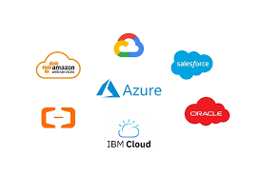
Cloud SERVICE Provider’s
  The term “cloud services” refers to a wide range of services delivered to companies and customers over the Internet. These services make it easy for employees to have access to various business applications and information. Whether they’re aware of it, from checking email to collaborating on documents, most employees use cloud services throughout the workday. Cloud computing vendors and service providers fully manage services provided through cloud computing. You don’t have to host applications on your servers. Instead, they can be accessed from the servers of a cloud service provider.

Slide 20
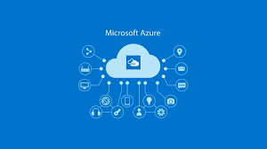
Cloud SERVICE Provider - AZURE
  Microsoft Azure is a cloud computing platform and service offered by Microsoft that provides a wide range of solutions including computing, storage, networking, databases, AI, and DevOps tools. It enables organizations to build, deploy, and manage applications through Microsoft-managed data centers across the globe. Azure supports hybrid cloud setups, multiple programming languages, and frameworks, making it ideal for businesses of all sizes to scale efficiently and securely.

Slide 21

Cloud SERVICE Provider - AWS
  Amazon Web Services (AWS) is a comprehensive cloud computing platform by Amazon that offers on-demand services such as computing power, storage, databases, machine learning, and analytics. It enables businesses to build and scale applications efficiently through a global network of data centers. Known for its flexibility, security, and vast service offerings, AWS supports various workloads including web hosting, big data, DevOps, and enterprise applications.

Slide 22
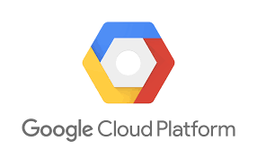
Cloud SERVICE Provider - GCP
  Google Cloud Platform (GCP) is a suite of cloud computing services offered by Google that enables organizations to build, deploy, and scale applications using Google’s infrastructure. It provides services for computing, storage, databases, machine learning, analytics, and more. GCP is known for its strong data analytics capabilities, AI tools, and integration with open-source technologies. It supports modern cloud-native development and offers a secure, scalable environment for businesses of all sizes.

Slide 23
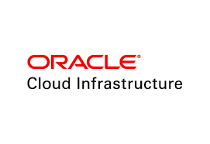
Cloud SERVICE Provider - ORACLE
  Oracle Cloud is a cloud computing platform offered by Oracle that provides a comprehensive suite of services, including computing, storage, databases, analytics, AI, and enterprise applications. It is known for its powerful database services, especially Oracle Autonomous Database, and is designed for high performance, security, and scalability. Oracle Cloud supports hybrid and multi-cloud environments, making it ideal for enterprise workloads and mission-critical applications.

Slide 24
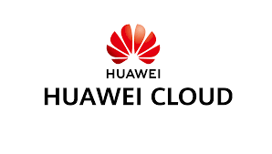
Cloud SERVICE Provider - HUAWEI
  Huawei Cloud is a cloud computing platform provided by Huawei, offering a wide range of services including computing, storage, AI, big data, and networking. It supports digital transformation for businesses across various industries with a focus on innovation, security, and cost-efficiency. Known for its strong presence in Asia, Huawei Cloud enables scalable and intelligent cloud solutions, and supports hybrid and multi-cloud environments.

Slide 25
Cloud SHARED RESPONSIBILITY
Day 1

Slide 26
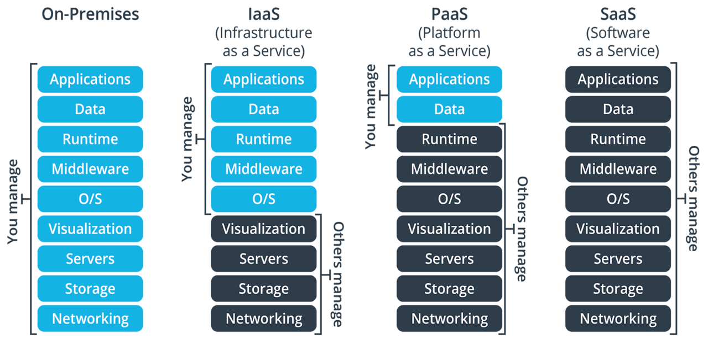
RESPONSIBILITY MATRIX

Slide 27
Securing Cloud Infrastructure and Data
Day 1

Slide 28

Securing Cloud Infrastructure and Data
  Identity and Access Management (IAM)
    IAM is the framework of policies and technologies that ensures the right individuals have the appropriate access to technology resources in cloud environments. It is foundational to securing cloud infrastructure, as it controls who can access what, when, and how.

Slide 29

Securing Cloud Infrastructure and Data
  Network Security
    Network security is a critical pillar in protecting cloud infrastructure by controlling and monitoring the flow of data between systems, users, and services. It ensures that only authorized traffic is allowed, prevents unauthorized access, and detects malicious activities within the network.

Slide 30
Refresher- LAST CLASS
Cloud Computing Concepts
  Introduction to Cloud Computing
  Introduction to Cloud Computing Models (IaaS, SaaS, PaaS)
  Benefits and Challenges of Cloud Computing
  Cloud Service Providers (AWS, Azure, GCP, Huawei & Oracle)
  Cloud Security Basics (Shared Responsibility Model)
  Securing Cloud Infrastructure and Data
  Compliance in the Cloud
  Class Demo and Assignment

Slide 31
MONTH 4 - WEEK 1
Identity and Access Management
  Introduction to Identity and Access Management Principles
  Core Concepts - Identification, Authentication, Authorization, Accountability
  Benefits and Challenges of Cloud Computing
  Cloud Service Providers (AWS, Azure, GCP, Huawei & Oracle)
  Cloud Security Basics (Shared Responsibility Model)
  Securing Cloud Infrastructure and Data
  Compliance in the Cloud
  Class Demo and Assignment

